Slide 1
Containers
Week 3
CLO835, Summer 2022

Slide 2
Agenda
Docker Networks Lab
Build and Push to Amazon ECR with GitHub Actions Lab
Docker Storage Lab

Slide 3
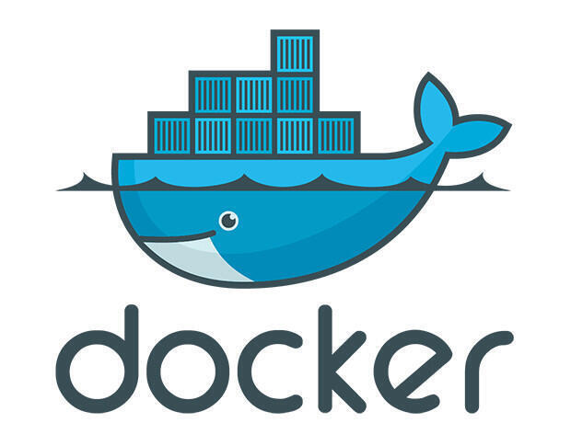
Lab 1– Docker Networks

Slide 4
List the networks
$ docker network ls
NETWORK ID NAME DRIVER
6bde79dfcf70 bridge bridge
8d9c78725538 none null
eb0eeab782f4 host host
4c1ff84d6d3f blog-dev overlay
228a4355d548 blog-prod overlay
# Create a new network
$ docker network create [network name]

Slide 5
What's a network?
Conceptually, a Docker "network" is a virtual switch
(we can also think about it like a VLAN, or a WiFi SSID, for instance)
By default, containers are connected to a single network
(but they can be connected to zero, or many networks, even dynamically)
Each network has its own subnet (IP address range)
A network can be local (to a single Docker Engine) or global (span multiple hosts)
Containers can have network aliases providing DNS-based service discovery
(and each network has its own "domain", "zone", or "scope")

Slide 6
Basic Connectivity and DNS
$ docker run -it -d --name ubuntu1 ubuntu
$ docker run -it -d --name ubuntu2 ubuntu
$ docker inspect ubuntu1 # What network is this container using
# Try pinging ubuntu1 from the host using it’s IP and DNS
$ ping 172.12.0.3
$ ping ubuntu2
# Ty the same from inside the container ubuntu1
$ docker exec -it ubuntu2 /bin/sh
# ping 172.12.0.3
# ping ubuntu2

Slide 7
# Create a new network
docker network create -d bridge --subnet 182.18.0.1/24 --gateway 182.18.0.1 new-network
# Deploy a mysql database using the mysql:5.6 image and name it mysql-db. Attach it to the newly created network new-network Set the database password to use db_pass123. The environment variable to set is MYSQL_ROOT_PASSWORD
$ docker run -d -e MYSQL_ROOT_PASSWORD=db_pass123 --name mysql-db --network new-network mysql:5.6
# Run a simple app and link it to DB container
$ docker run --network=new-network -e DB_Host=mysql-db -e DB_Password=db_pass123 -p 38080:8080 --name webapp --link mysql-db:mysql-db -d kodekloud/simple-webapp-mysql
# Can containers on a default “bridge” network connect to containers on “new-network”?

Slide 8
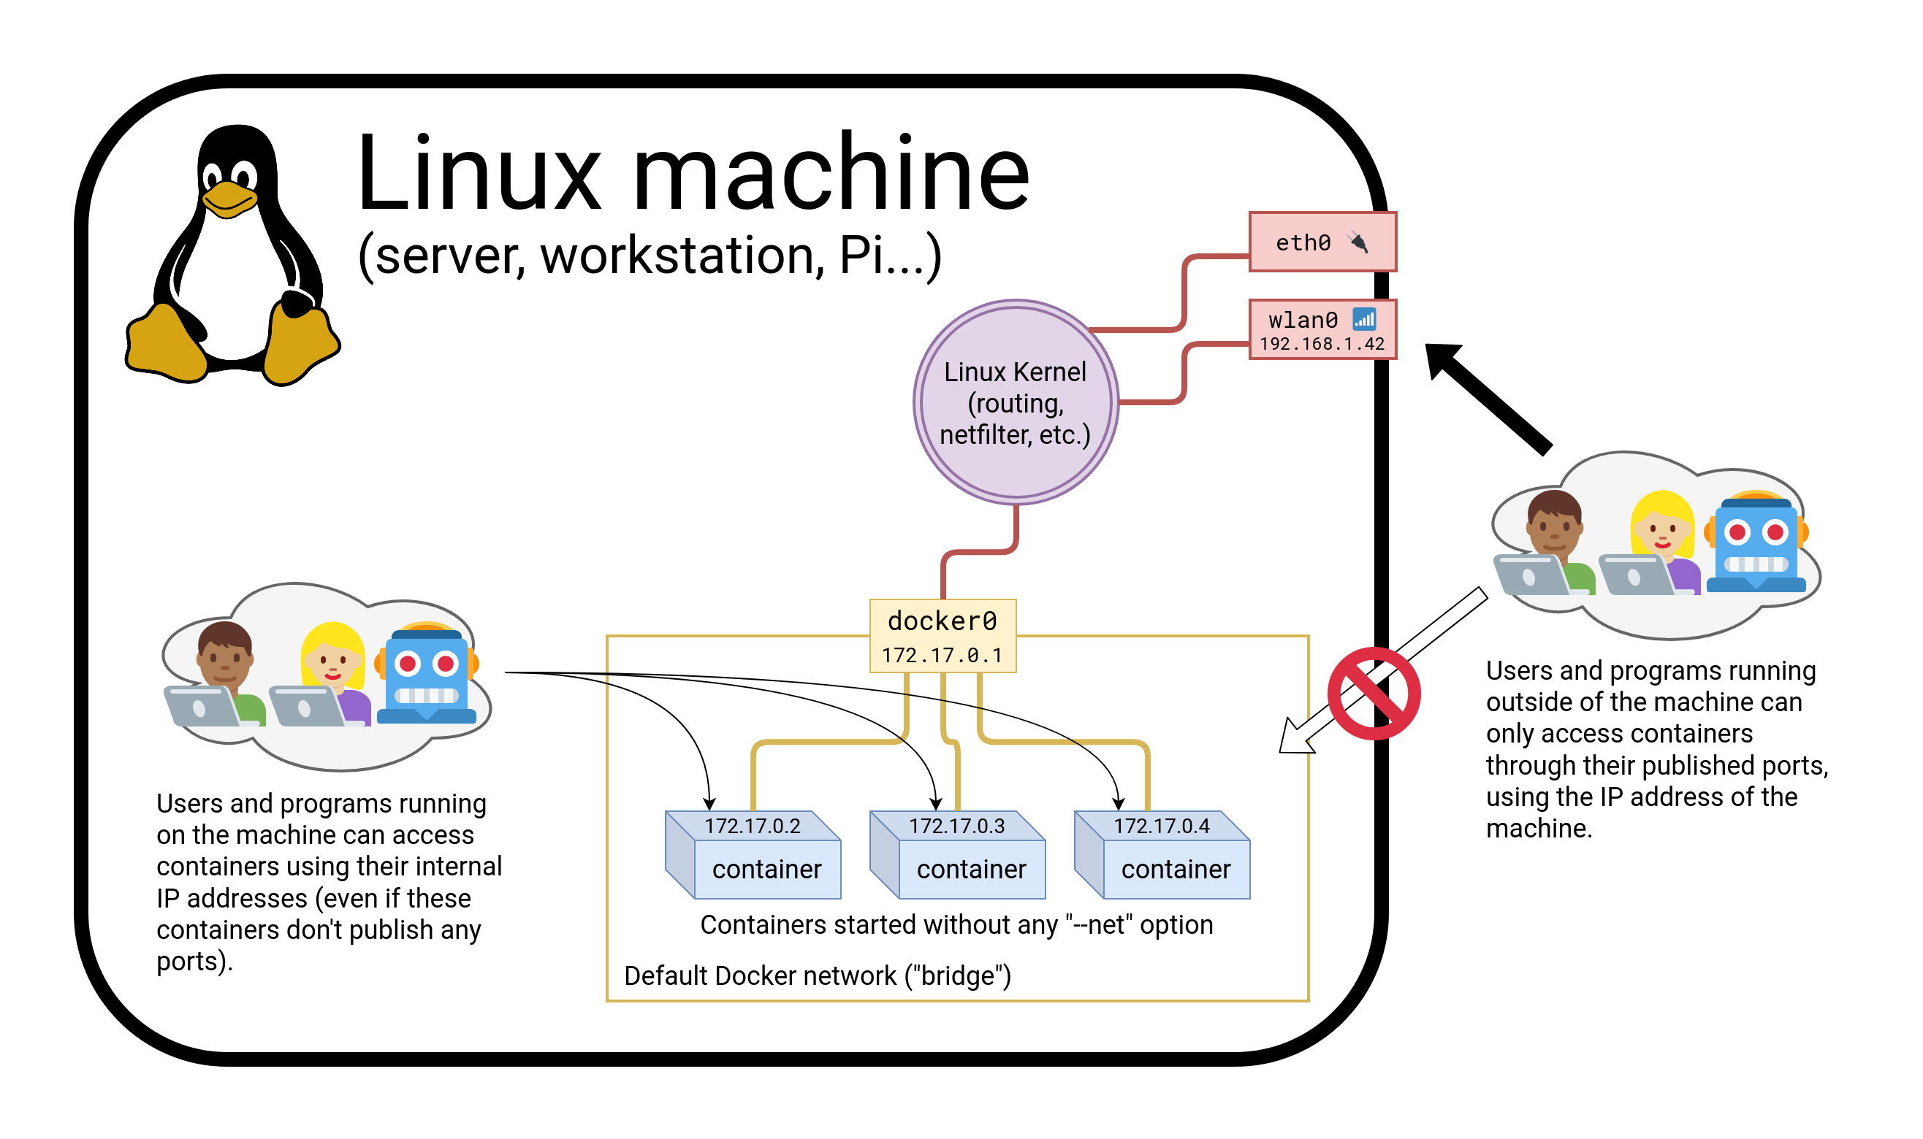
Connectivity Explained

Slide 9
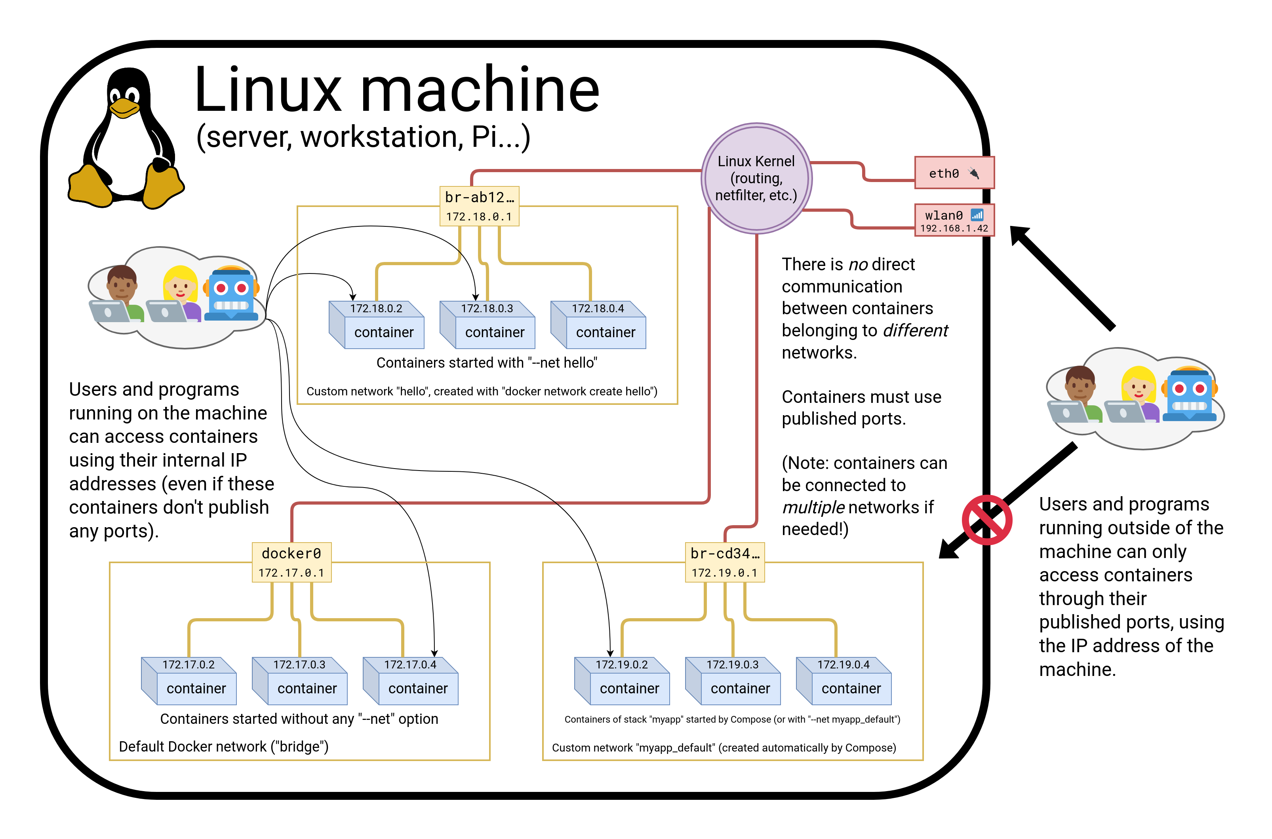

Slide 10
CNM vs CNI
CNM is the model used by Docker
Kubernetes uses a different model, architecture around CNI
(CNI is a kind of API between a container engine and CNI plugins)
Docker model:
multiple isolated networks
per-network service discovery
network interconnection requires extra steps
Kubernetes model:
single flat network
per-namespace service discovery
network isolation requires extra steps (Network Policies)

Slide 11
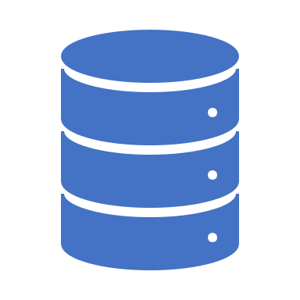
Service discovery with containers
Let's try to run an application that requires two containers.
The first container is a web server.
The other one is a redis data store.
We will place them both on the ”new-network” network created before.

Slide 12
$ docker run --net new-network -d -P jpetazzo/trainingwheels
# Check the port that has been allocated to it:
$ docker ps –l
# If we connect to the application now, we will see an error page
# Start the container:
$ docker run --net new-network --net-alias redis -d redis
# That container must be on the same network as the web server.
# It must have the right network alias (redis) so the application can find it. Mind the dot!
$ docker run --net new-network --rm alpine nslookup redis.

Slide 13
Lab 1– The End

Slide 14
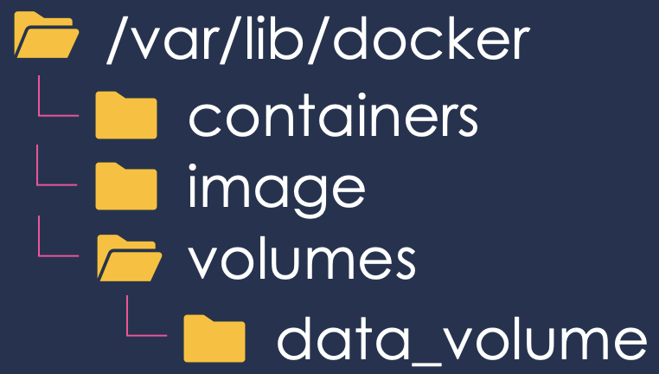
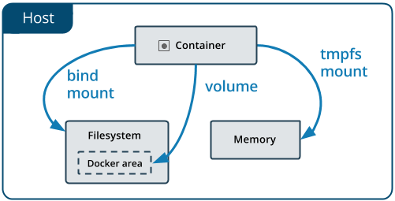
Docker Storage
Notes:
https://docs.docker.com/storage/

Slide 15
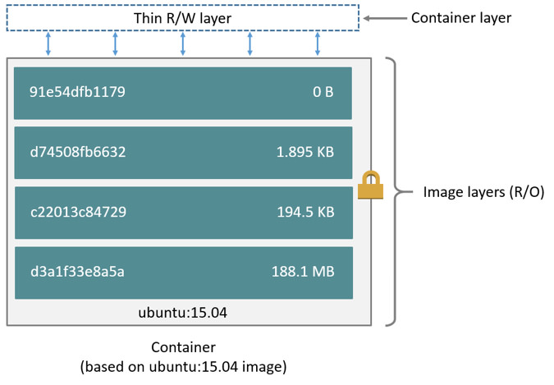
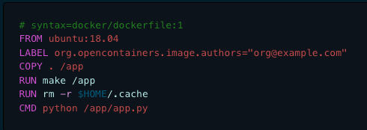
Docker Layers

Slide 16
Making changes to the code
Option 1:
Edit the code locally
Rebuild the image
Re-run the container
Option 2:
Enter the container (with docker exec)
Install an editor
Make changes from within the container
Option 3:
Use a bind mount to share local files with the container
Make changes locally
Changes are reflected in the container

Slide 17
Lab 2 – Docker Storage

Slide 18
Running MySQL DB as a container
# Run MySQL DB as a container
$ docker run --name mysql-db -d -e MYSQL_ROOT_PASSWORD=db_clo835 mysql
# Add some data to the DB and print it out
$ docker exec –it mysql-db /bin/bash
# mysql –pdb_clo835
# create database foo;
# use foo;
# create table myTable (name VARCHAR(20), owner VARCHAR(20), species VARCHAR(20), sex CHAR(1), birth DATE, death DATE);
# INSERT INTO myTable VALUES ('Puffball','Diane','hamster','f','1999-03-30',NULL);
# select * from myTable;
$ docker exec mysql-db mysql –pdb_clo835 –e ’use foo; select * from myTable’
# Stop and delete the container
$ docker stop <container id>
$ docker rm <container id>
# Explain: What happened to the data when we removed the container and why?

Slide 19
Running MySQL DB as a Container with a mounted volume
# Add persistent volume binding and re-run
$ docker run --name mysql-db -d -e MYSQL_ROOT_PASSWORD=db_pass123 -v /opt/data:/var/lib/mysql mysql
# Create DB and populate it with some entries
$ docker exec mysql-db /bin/sh
..
# Stop and delete the container
$ docker stop <container id>
$ docker rm <container id>
# Explain: What happened to the data and why?
$ docker run --name mysql-db -d --env MYSQL_ROOT_PASSWORD=db_pass123 -v /opt/data:/var/lib/mysql mysql
$ docker exec mysql-db mysql –pdb_clo835 –e ’use foo; select * from myTable’

Slide 20
Running MySQL DB as a Container with a mounted volume
The -v /path/on/host:/path/in/container syntax is the "old" syntax
The modern syntax looks like this:
--mount type=bind,source=/path/on/host,target=/path/in/container
--mount is more explicit, but -v is quicker to type
--mount supports all mount types; -v doesn't support tmpfs mounts
--mount fails if the path on the host doesn't exist; -v creates it
With the new syntax, our command becomes:
$ docker run --mount=type=bind,source=/opt/data,target= /var/lib/mysql -d mysql-db

Slide 21
Lab 2 – The End

Slide 22
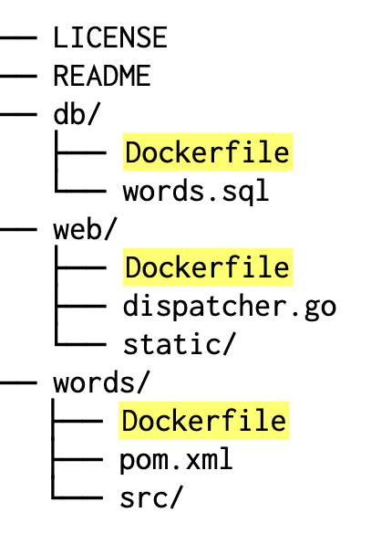
Build the Docker Image in Cloud9 Environment
In your Cloud9 environment, change directory and clone our application source repo
https://github.com/jpetazzo/wordsmith
For now, we only care about the first part (about writing Dockerfiles). Place each Dockerfile in its own directory, like this
$ git clone https://github.com/jpetazzo/wordsmith.git
$ cd wordsmith

Slide 23
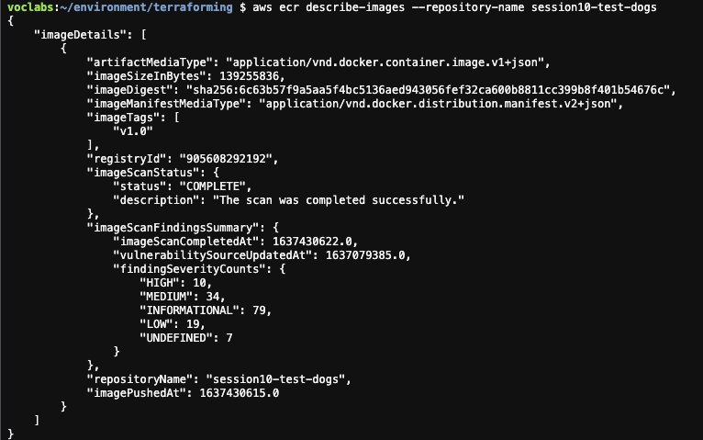
Build the Docker Image in Cloud9 and Publish To Amazon ECR
# Verify the image is in Amazon ECR
aws ecr dscribe-images –repository-name session10-test-dogs

Slide 24
Lab 3 – Build Docker Image and Publish to Amazon ECR with GitHub Actions

Slide 25
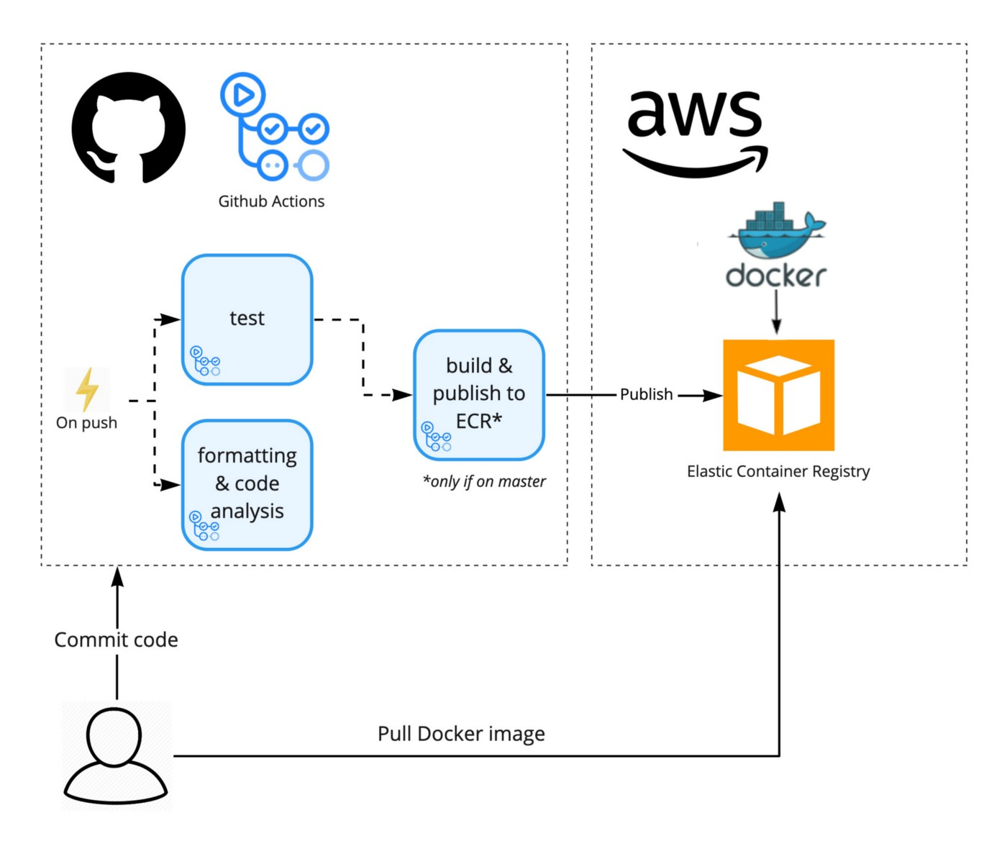
Build Docker Images with GitHub Actions
Notes:
https://aws.plainenglish.io/build-a-docker-image-and-publish-it-to-aws-ecr-using-github-actions-f20accd774c3

Slide 26
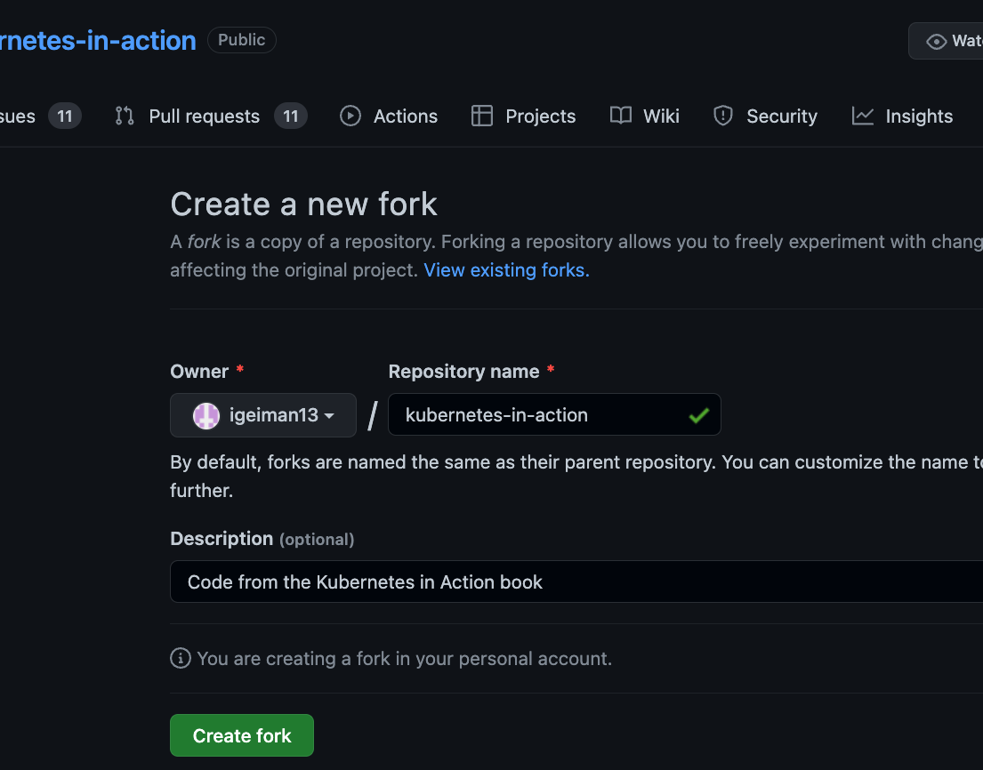
Create a Fork of the Application Repo
# Fork the repo
https://github.com/luksa/kubernetes-in-action/fork
Notes:
https://towardsaws.com/build-push-docker-image-to-aws-ecr-using-github-actions-8396888a8f9e

Slide 27
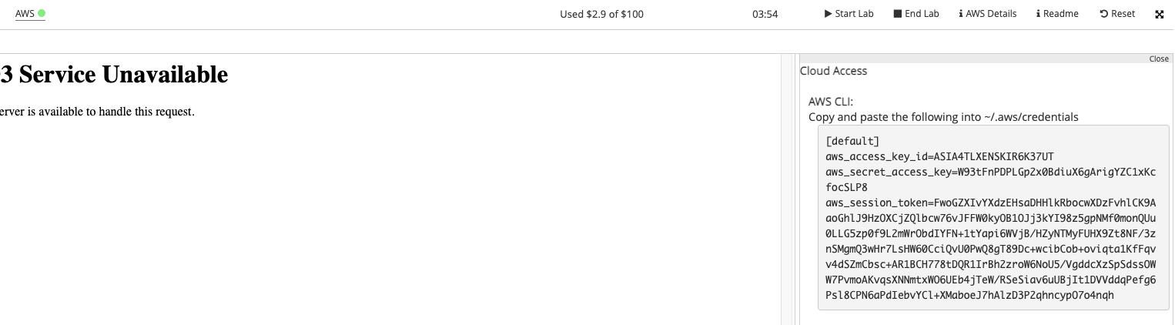
Create a Repository for Your Images
# Create an Amazon ECR repository using CLI from your AWS Academy or Cloud9 Terminal
$ aws ecr create-repository --repository-name clo835-week3
# Retrieve temporary credentials from AWS Academy. Select AWS Details and then Click on "Show" under AWS CLI.

Slide 28
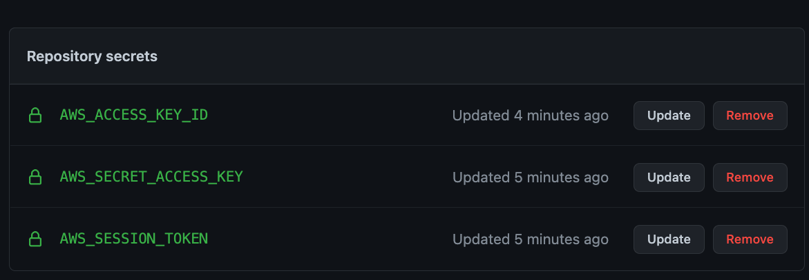
Update Your Repo with AWS Credentials
In your repository, select Settings=>Secrets, click on "New repository secrets" and add the secrets below.

Slide 29
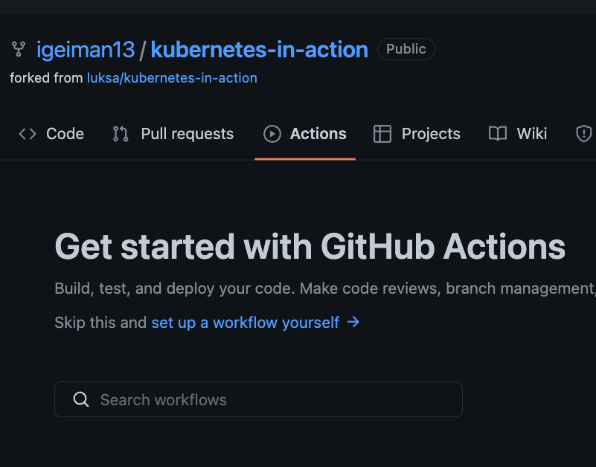
Create GitHub Actions Workflow
In the forked repo, click on Actions and select "set up workflow yourself"
Copy the workflow from the GitHub link

Slide 30
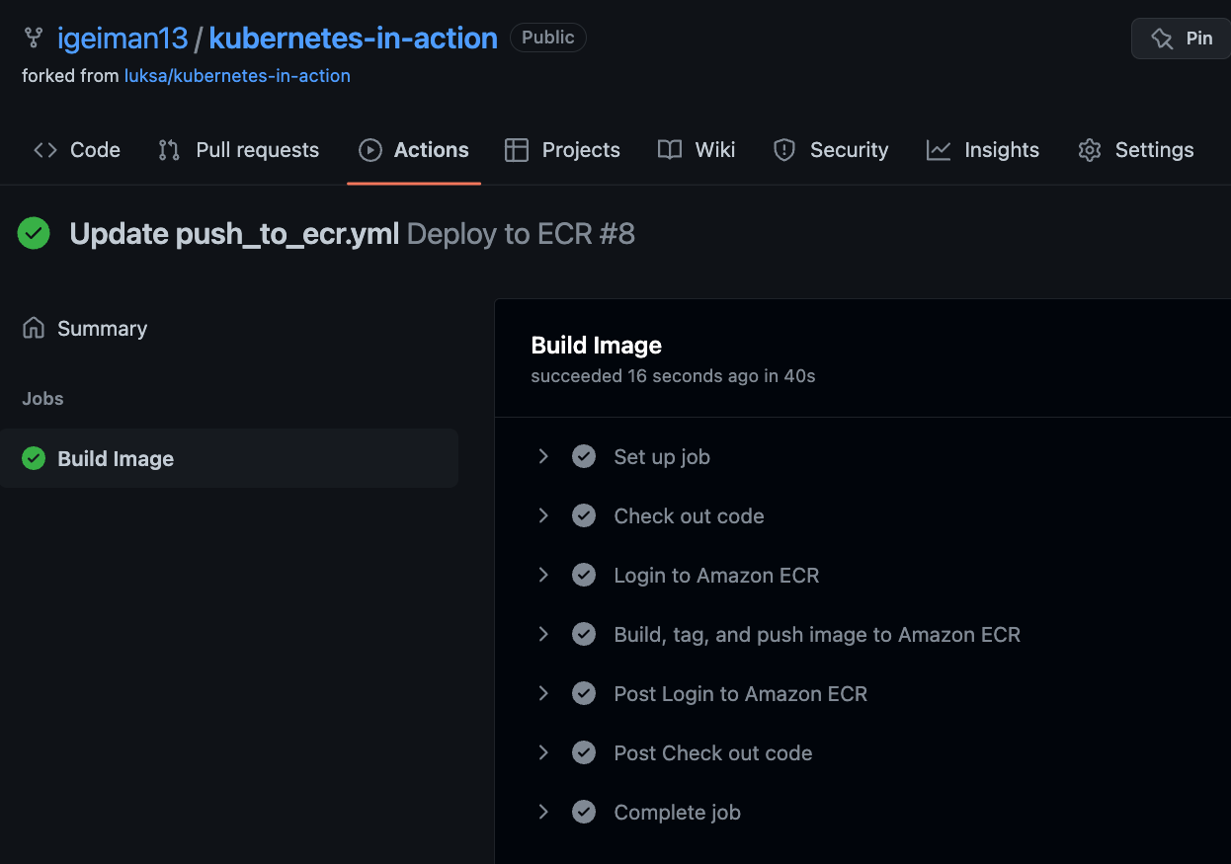
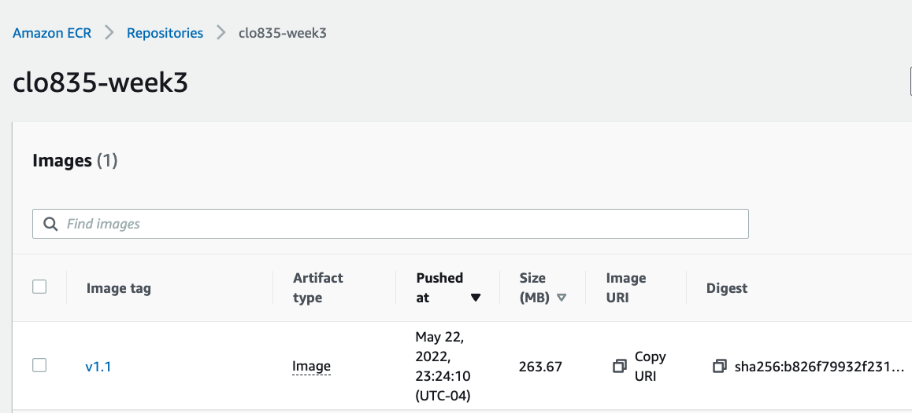
Verify that the Docker Image is available in Registry

Slide 31
Run the container in Cloud9
# Export environment variable
$ export ECR=866222632084.dkr.ecr.us-east-1.amazonaws.com/clo835-week3
# Log into docker registry to get permissions to pull an image
$ aws ecr get-login-password --region us-east-1 | docker login -u AWS ${ECR} --password-stdin
# Start the webserver
$ docker run -d -p 80:8080 866222632084.dkr.ecr.us-east-1.amazonaws.com/clo835-week3:v1.1
# Verify that the application is running
$ curl localhost
# Explain: how would you run two instances of the same application on the Cloud9 machine? Update the message printed by the application, build a new image and show it in the browser. The new and the old version of the application should run simultaneously.

Slide 32
Lab 3 – The End

Slide 33
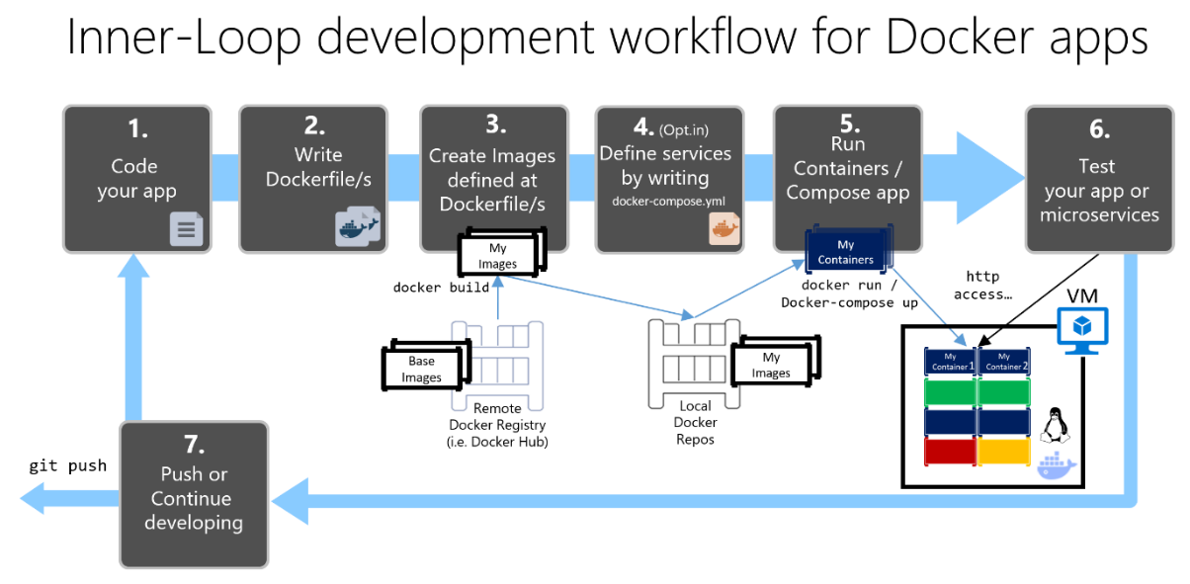
Lifecycle

Slide 34
Docker Architecture: Namespaces
Docker takes advantage of Linux namespaces to provide isolated workspace we call "container"
Some namespaces on Linux:
PID namespace for processes isolation (PID: Process ID)
Net namespace for network isolations, manages network interfaces
IPC namespace: inter-process communication
Mnt namespace to manage mount points

Slide 35



Docker Architecture: Control Groups
Docker engine uses another Linux technology called cgroups or control groups
Cgroups are responsible for limiting resources used by the container
Cgroups ensures that containers are good multi-tenant citizens on the host
Cgroups allow Docker engine to share available VM resources between containers and set limits and constraints, if required

Slide 36
Docker Engine
Docker Engine is a client server application with the main components below
A server which is a long-running process called Docker daemon
REST ALPI that defines interface that docker client can use to talk to the daemon and instruct it what to do
CLI client

Slide 37
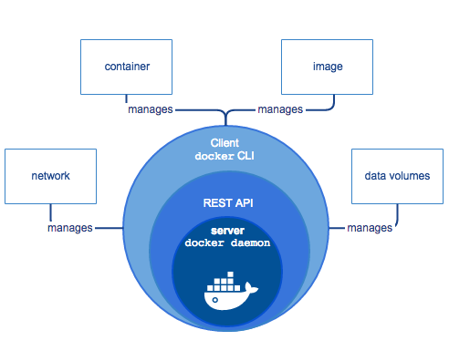
Docker Engine

Slide 38
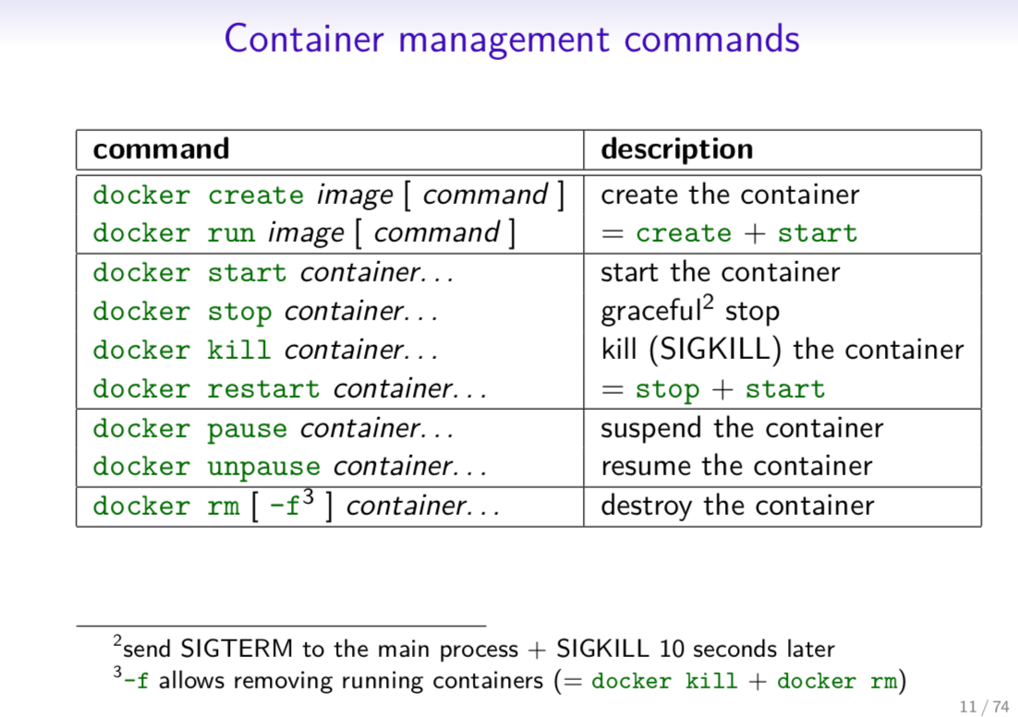
Docker commands

Slide 39
Useful links
https://docs.aws.amazon.com/AmazonECS/latest/developerguide/docker-basics.html
https://ecs-cats-dogs.workshop.aws/en/ecr/docker.html
https://blog.aquasec.com/docker-security-best-practices?_ga=2.100580638.1058616926.1651978295-1119178887.1645428243
https://github.com/luksa/kubernetes-in-action
https://towardsaws.com/build-push-docker-image-to-aws-ecr-using-github-actions-8396888a8f9e
https://iximiuz.com/en/posts/container-networking-is-simple/
11/12/2021

